Slide 1


HYATT REGENCY HOTEL IN KANSAS CITY COLLAPSE – A CASE STUDY
http://pmsymposium.umd.edu/pm2017/
Shulman
2017 Project Management Symposium

Slide 2
HYATT REGENCY HOTEL IN KANSAS CITY COLLAPSE – A CASE STUDY
On July 17, 1981, two suspended walkways collapsed in the atrium of the Hyatt Regency Hotel in Kansas City.
It was the deadliest structural collapse at the time in the history of the United States.
Approximately 2,000 people had gathered in the atrium to participate in and watch a dance contest. Dozens stood on the walkways. One hundred fourteen people were killed.
It was an accident that could have been prevented if a better coordinated engineering review had taken place in the design shop drawing process.

Slide 3
The hotel’s design called for walkways to span the atrium at the second and fourth floors.
The original design specified continuous hanger rods run from the ceiling through the fourth-floor beams and on through to the second-floor beams.

Slide 4
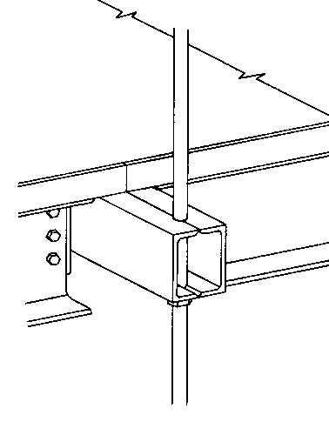
Walkway as Designed
Box beams of 4th floor walkway was designed to carry only the 4th floor load

Slide 5
During the course of construction, design shop drawings prepared by the steel fabricator suggested that a set of two hanger rods replace the single hanger rod between the second and fourth-floor walkways.
This change doubled the load.
The design shop drawings were stamped by the architect, structural engineer, and contractor indicating their review.

Slide 6
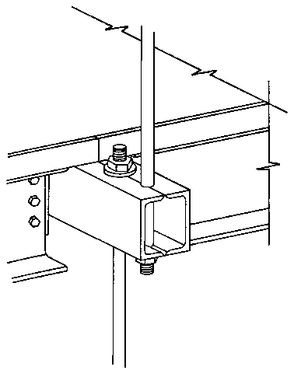
Walkway as Built
Box beam of 4th floor carried the 4th floor load and the 2nd floor load

Slide 7
Before and After

Slide 8
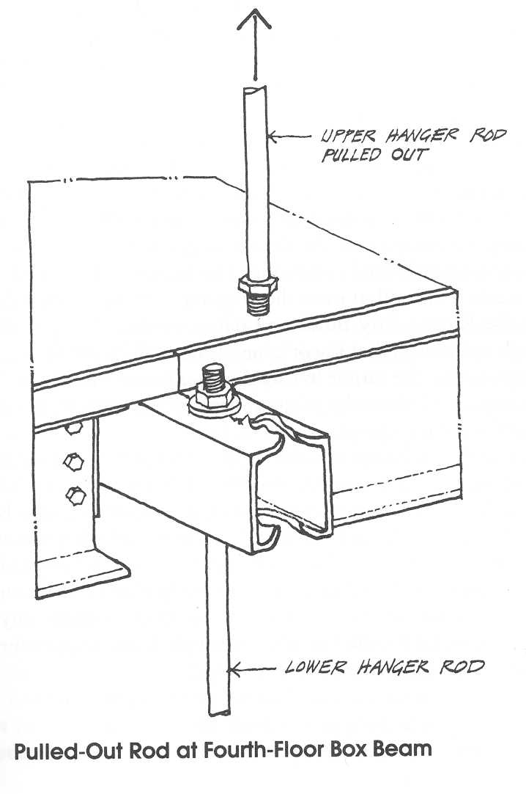
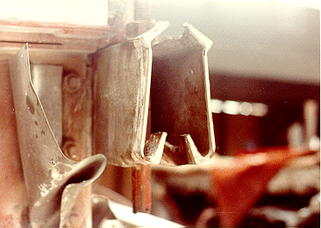
The Upper Rod Pulled out @ the 4th floor box beam

Slide 9
This building’s failure illustrates the importance of good communication among the project participants, since any engineer or architect who took the time to review the impact of this change could have seen the possibility of a structural problem.
Unfortunately, it appears that each reviewer stamped the submittal but assumed that someone else would complete the review.
According to the specifications for the project, no work could start until the design shop drawings for the work had been approved by the structural engineer.

Slide 10
The judge held the structural engineering consultants liable for the accident.

Slide 11
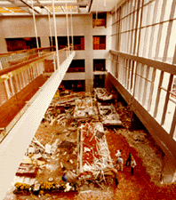
Photo After the Collapse

Slide 12
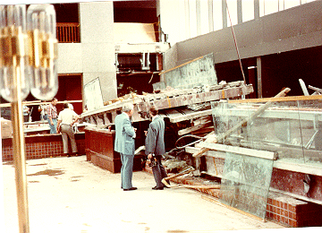
Photo After the Collapse

Slide 13
SEQUENCE OF EVENTS
Spring 1978: Hyatt awards building contract and hotel construction begins.
December 1978: The general contractor on the enters into subcontract with steel contractor to erect the atrium steel.
January–February 1979: Events and communications between the structural engineers and the steel contractor determine a design change from a single to a double hanger rod box beam connection for use at the fourth floor walkways.
Alleged telephone calls concerning this proposed change were later disputed by the structural engineers; however, because of alleged communications between engineer and fabricator, Shop Drawing 30 and Erection Drawing E3 are changed.
February 1979: The structural engineers receive 42 design shop drawings (including Shop Drawing 30 and Erection Drawing E-3) and returns them to steel contractor, with engineering review stamp approval on February 26.

Slide 14
October 14, 1979: Part of the atrium roof collapses while the hotel is under construction. Inspection team called in. Their contract dealt primarily with the investigation of the cause of the roof collapse and created no obligation to check any engineering or design work beyond the scope of that investigation and contract.
October 16, 1979: Owner retains an independent engineering firm, to investigate the cause of the atrium roof collapse.
October 20, 1979: The structural engineer firm writes the owner, stating they are undertaking both an atrium collapse investigation, as well as a thorough design check of all the members comprising the atrium roof.
October–November 1979: Reports and meetings from structural engineer to owner/architect, assuring overall safety of the entire atrium.
July 1980: Construction of hotel complete, and the Kansas City Hyatt Regency Hotel opened for business.
July 17, 1981: Connections supporting rods from the ceiling that held up the second and fourth floor walkways across the atrium of the Hyatt Regency Hotel collapse, killing 114 and injuring in excess of 200 others.

Slide 15
November, 1984: The structural engineers were found guilty of gross negligence, misconduct and unprofessional conduct in the practice of engineering.
Subsequently, the structural engineers lost their licenses to practice engineering in the State of Missouri, and had its certificate of authority as an engineering firm revoked.
American Society of Civil Engineering (ASCE) adopts a report that states structural engineers have full responsibility for design projects.
The structural engineers subsequently were allowed to be practicing engineers in states other than Missouri.

Slide 16
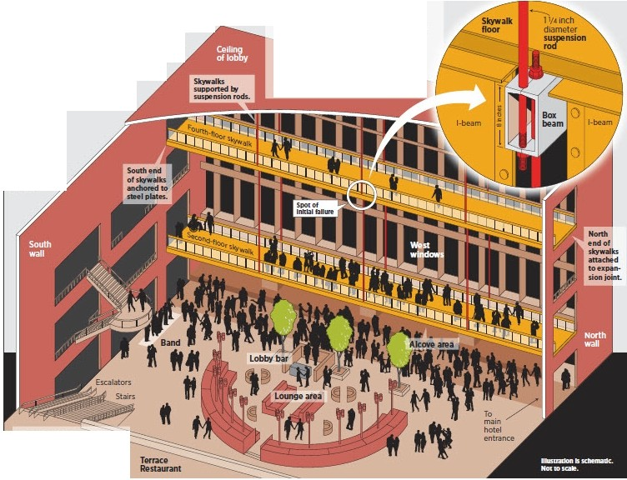
BEFORE THE COLLAPSE
Thelobby of theHyatt Regency hotel. with as open atrium. suspended walkways andinter,or landscaping. wasa sight to behold. and ttie.
w eekly tea danceswere very popularparties.
Thousands of people flocked to thehotel every Friday even;ng for the 1940 s-style dancecontestsand big-band
music.Theparty on July17. 1981.
began in typical fashion.
WHAT WAS BUILT
The original design called for six
single-rodassemblies. attached to st eel beams in theroof. to runcontinuousfy throughthe skywalk box beamson the fourth floorto the box beamson the
seconcHloor skywalk. But the n was changed during the constn,ction phase. and12shoretr rods were employed.
-··
NOTE: For clarity,
the tnitCM IC>«
i not
More than 60 people
were on the skywalks at the critical moment.Mostof them
wereonthesecond floor.

Slide 17
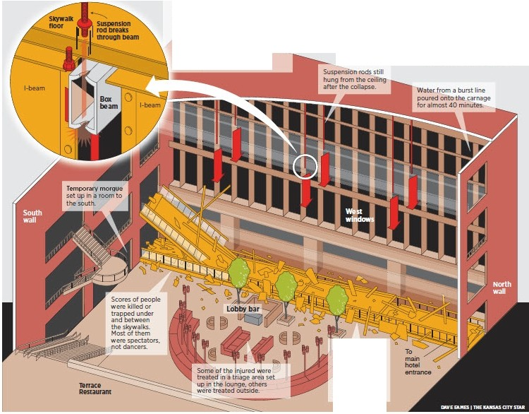
HOW IT FAILED
The changeto 12shorter rods facilitatedconstruction. but it wasn' t sound engineering. The
AFTER THE COLLAPSE
At 7:05p.m..the sk>jwalksfell witha loud snapanda deafening crash. instantly killingscoresof people who were pancakedbetween the twoskywalksor under them both. Some survivedin air pocketscreated1:>J the
16·inchsupportingl·beams.
loadon the fourth·floor boxbeams
wa' s doublec[ \Yheooneconnec·
tion failed. thfy all faile,d sencHng almost 72 tonsof concre-te and steel to tfle.floor.
••
Emergency
re-scuebegan
immediately. and the search
for survivors
continued well
into thena t day.

Slide 18
