Slide 1
Types of Biomolecules
Carbohydrates
Lipids
Proteins
Nucleic Acids

Slide 2
Carbohydrates
Carbohydrate means “hydrated” carbon
Comprising elements C, H, O
Hydrogen and Oxygen are in a ratio of 2:1
Can be simple monomers like glucose
Can be complex polymers like cellulose

Slide 3
Groups of Carbohydrates
Carbohydrates
Sugars
Monosaccharides (monomers)
Disaccharides( Dimers)
Polysaccharides (polymers)

Slide 4
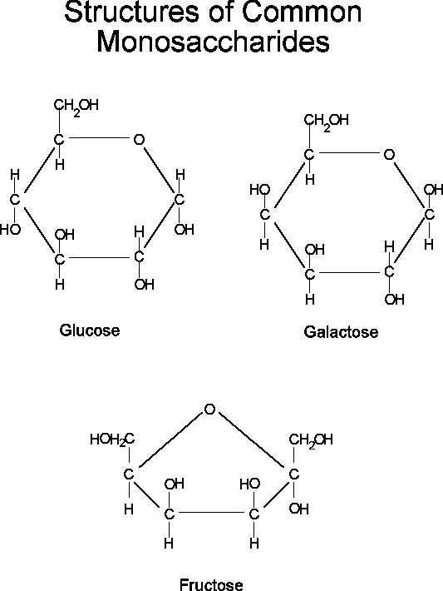
Monosaccharides
C₆H₁₂O₆
Fructose
Galactose
Glucose

Slide 5
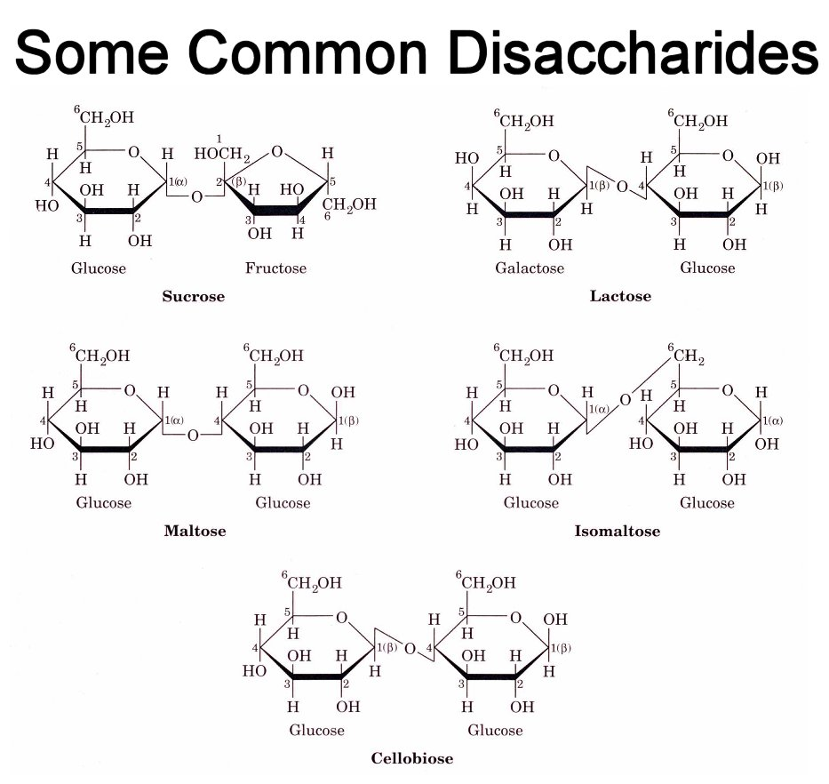
Disaccharides
Lactose: glucose + galactose
Maltose: glucose + glucose
Sucrose: glucose + fructose
sucrose
Notes:
Lactose: found in milk produced by lactating mammals only. Enzyme, lactase (also called galactosidase ), breaks apart the two sugars so they can be separately metabolized.
All human infants produce enzyme lactase
Majority of adult humans (especially of Asian, African, Eastern European ancestries) lose ability to hydrolyze this compound, due to genetic inability to produce lactase enzyme as adults. They are lactose-intolerant , suffer severe intestinal cramping when lactose is eaten (because bacteria in gut now have access to it, generate gaseous and acid byproducts by fermentation).
Maltose:Found in barley, used in beer-making process, also for malted milk drinks
Sucrose: found in sugar cane and sugar beet. Used to be the major sugar used for sweetening foods, soft drinks, etc.
Economies of many 3rd world countries were based on supplying sugar.
But soft drink companies switched to fructose (from corn products, largely from U.S. and Europe) in 1980's, caused tremendous global economic impact, many countries lost trade.

Slide 6
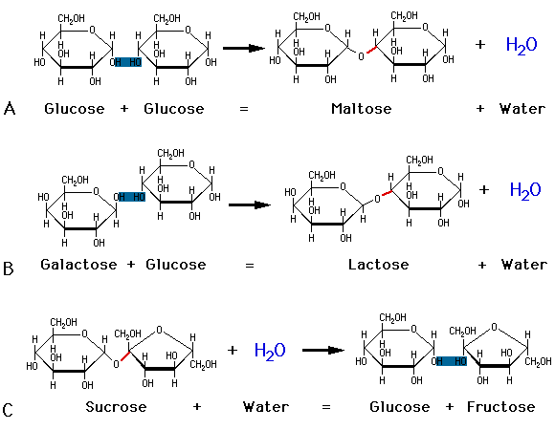
Condensation to form Disaccharides
Notes:
Images:http://images.google.com/imgres?imgurl=http://www.agen.ufl.edu/~chyn/age2062/lect/lect_02/of2_6.gif&imgrefurl=http://www.agen.ufl.edu/~chyn/age2062/lect/lect_02/lect_02.htm&h=490&w=738&sz=10&tbnid=BolDwkhEmk2UQM:&tbnh=92&tbnw=139&hl=en&start=5&prev=/images%3Fq%3Dmonosaccharides%26svnum%3D10%26hl%3Den%26lr%3D

Slide 7
Purpose of Carbs:
1. Energy storage
Sugar = short term
Starch = long term plants
Glycogen = long term animals
2. Structural
Cellulose, Lignin, Chitin, etc
3. Cell signaling
Cell receptors

Slide 8
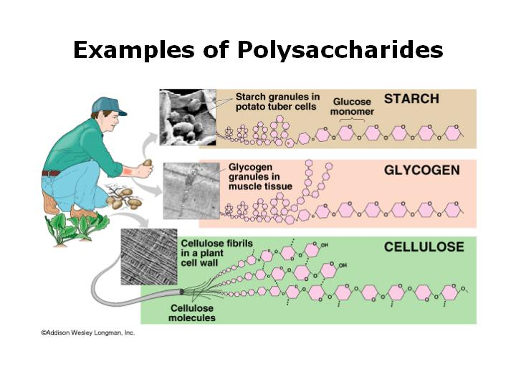
Polysaccharides
Notes:
Image:http://images.google.com/imgres?imgurl=http://www.ualr.edu/~botany/monosacs.jpg&imgrefurl=http://www.ualr.edu/~botany/botimages.html&h=540&w=720&sz=41&tbnid=mPgkjhRumTIyKM:&tbnh=104&tbnw=139&hl=en&start=22&prev=/images%3Fq%3Dmonosaccharides%26start%3D20%26svnum%3D10%26hl%3Den%26lr%3D%26sa%3DN

Slide 9
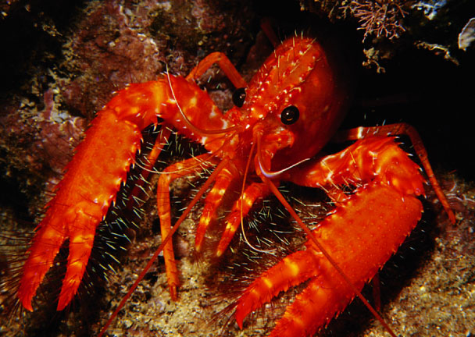
Structural Carbohydrates
Chitin – arthropod exoskeleton and fungal cell wall
  modified form of cellulose

Slide 10
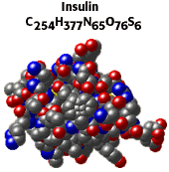
Proteins
C,H,O,N and some have S
(a few might also have P due to
addition of P in modification process
but P is not a component of amino acids)
insulin:C₂₅₄H₃₇₇N₆₅O₇₆S₆

Slide 11
Assembled in the Ribosomes
Amino acids are joined together by
PEPTIDE BONDS
following a sequence dictated by the DNA
DNA
Transcription
mRNA
Translation
Polypeptide/Protein

Slide 12
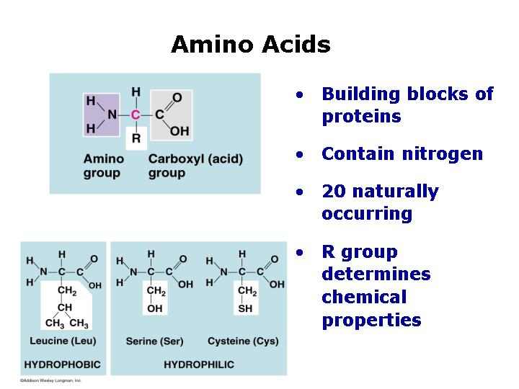
About half can be made by our body and about half need to be consumed(Between 8-10 are essential)
Notes:
22 amino acids are exist in protein only 20 are encoded in the DNA, two can be incorporated into protein by overriding stop or start codons. Some additional non protein incorporated amino acids also exist. Image:http://images.google.com/imgres?imgurl=http://www.ualr.edu/~botany/monosacs.jpg&imgrefurl=http://www.ualr.edu/~botany/botimages.html&h=540&w=720&sz=41&tbnid=mPgkjhRumTIyKM:&tbnh=104&tbnw=139&hl=en&start=22&prev=/images%3Fq%3Dmonosaccharides%26start%3D20%26svnum%3D10%26hl%3Den%26lr%3D%26sa%3DN

Slide 13
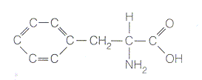


Amino Acids
Phenylalanine (phe)
Glutamine (gln)
Aspartic Acid (asp)

Slide 14
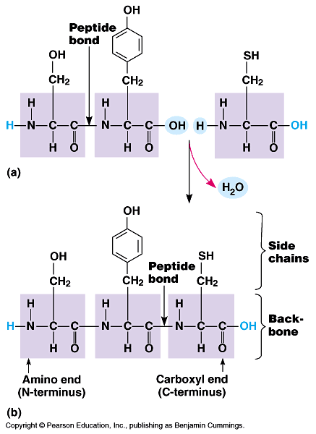

Slide 15
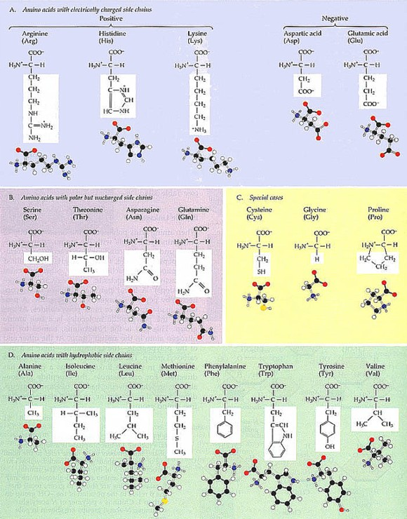
There are 20 different amino acids.
~half are mfg’d in the cell
~half must come from dietary uptake
Notes:
Amino acids don’t contain Phosphorus and most proteins don’t but phosphorylation is a part of post transcription processing in some proteins so some final proteins do.

Slide 16
Folding of polypeptides to form proteins
Shape or 3D architecture of a protein is important because
    This determines how they interact with other molecules
    This determines their particular function
You have >100,000 different protein types (each uniquely-shaped). Some say 200,000.

Slide 17
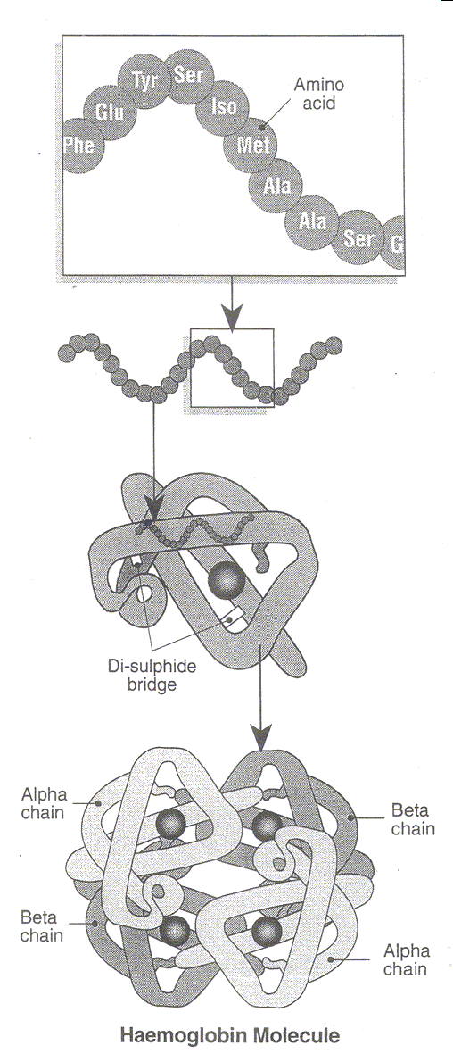
Primary structure
Peptide(phosphodiester) bonds
phe
glu
tyr
ser
iso
met
phe
glu
secondary
structure
Notes:
Primary structure is sometimes called the "covalent structure" of proteins because, with the exception of disulfide bonds (see below), all of the covalent bonding within proteins defines the primary structure. In contrast, the higher orders of proteins structure (i.e. secondary, tertiary and quartenary) involve mainly noncovalent interactions.
Secondary structure is "local" ordered structure brought about via hydrogen bonding mainly within the peptide backbone.
The most common secondary structure elements in proteins are the alpha (a) helix and the beta (b) sheet (sometime called b pleated sheet).

Slide 18
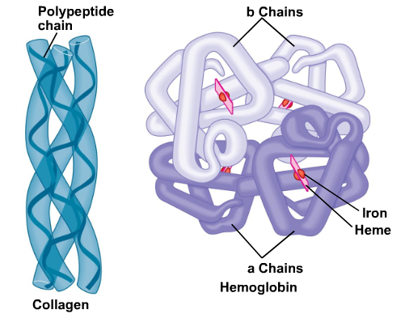
Tertiary Structure
Quaternary
Structure
Notes:
Tertiary structure is the "global" folding of a single polypeptide chain.
A major driving force in determining the tertiary structure of globular proteins is the hydrophobic effect. The polypeptide chain folds such that the side chains of the nonpolar amino acids are "hidden" within the structure and the side chains of the polar residues are exposed on the outer surface
Quartenary structure involves the association of two or more polypeptide chains into a multi-subunit structure.
Quartenary structure is the stable association of multiple polypeptide chains resulting in an active unit. Not all proteins exhibit quartenary structure. Usually, each polypeptide within a multisubunit protein folds more-or-less independently into a stable tertiary structure and the folded subunits then associate with each other to form the final structure.
Quartenary structures are stabilized mainly by noncovalent interactions; all types of noncovalent interactions: hydrogen bonding, van der Walls interactions and ionic bonding, are involved in the interactions between subunits. In rare instances, disulfide bonds between cysteine residues in different polypeptide chains are involved in stabilizing quartenary structure

Slide 19
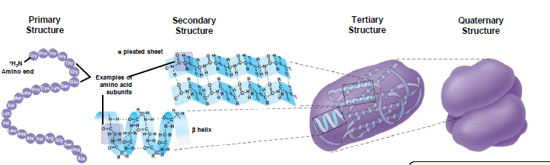
Protein 3D morphology

Slide 20
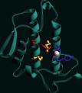
CATALYSTS: lipase

Slide 21
REGULATION: hormones
Insulin

Slide 22
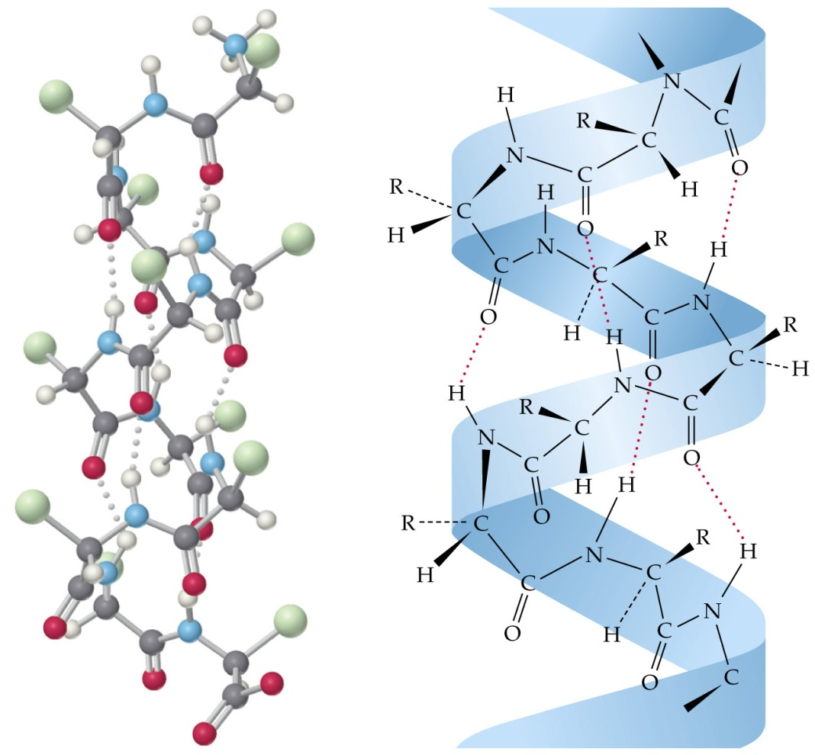
STRUCTURAL: Keratin

Slide 23
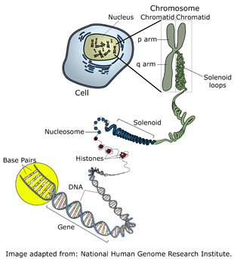
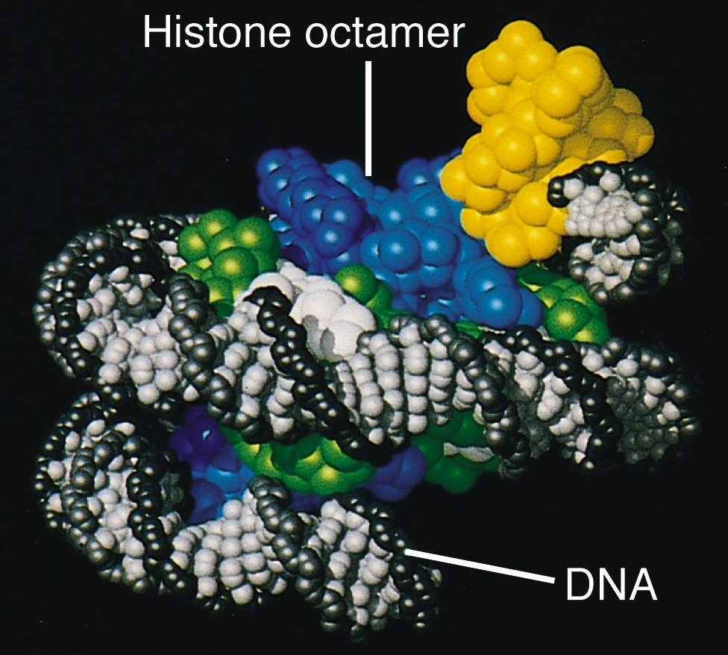
STRUCTURAL: Histone

Slide 24
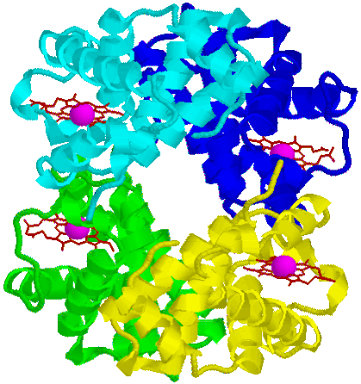
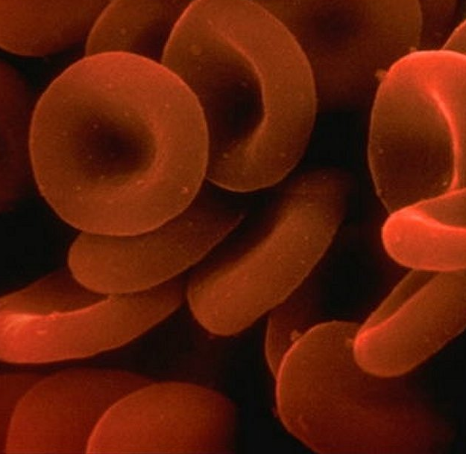
TRANSPORT: Hemoglobin

Slide 25
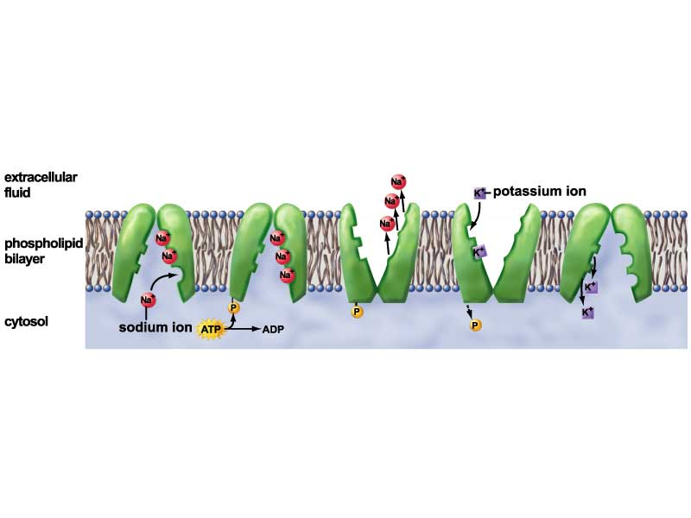
TRANSPORT: protein channels or carrier proteins

Slide 26
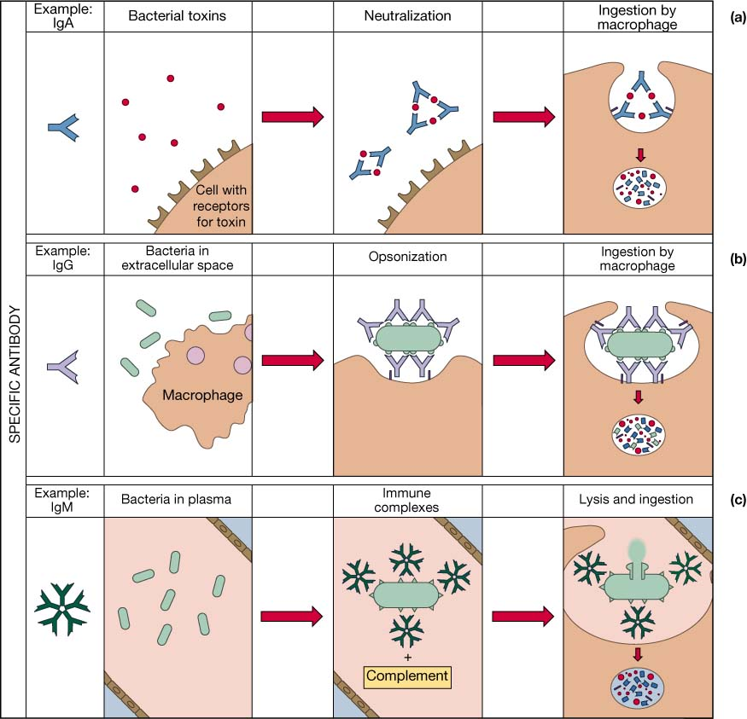
IMMUNITY: eg Antibodies

Slide 27
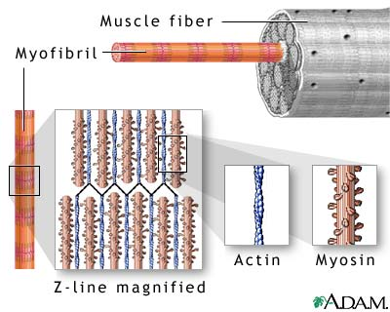
CONTRACTILE: Actin and Myosin

Slide 28
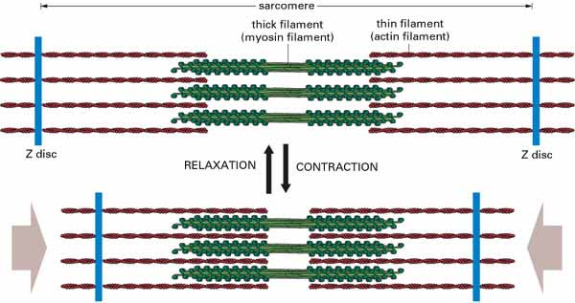
Muscle contraction and relaxation

Slide 29
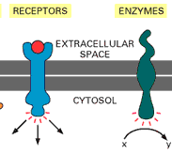
Surface receptors

Slide 30
Secondary Energy source
respiration

Slide 31
Lipids
Comprising elements C, H, O
Lipids are loosely defined as groups of organic molecules that are insoluble in water. Their chemical formula vary considerably.
Include:
  fats
  oils
  Waxes
  Phospholipids
  steroids: sex hormones and cholesterol
  some vitamins
  glycolipids (lipids with carbohydrates attached)

Slide 32
Lipid structure
Most lipids are composed of a of glycerol molecule with attached fatty acids
GLYCEROL
FATTY ACIDS
Glycerol
Fatty acid
Triglyceride
Fatty acid
Fatty acid
Phospholipid
GLYCEROL
HYDROPHOBIC END
Glycerol
Fatty acid
PO₄
Fatty acid
FATTY ACIDS
HYDROPHYLIC END

Slide 33
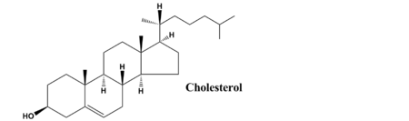
Lipid structure
Some lipids have a four ringed structure
Eg. Cholesterol and other lipids that are derived from cholesterol

Slide 34
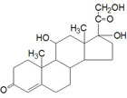
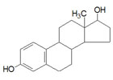
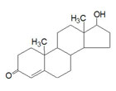
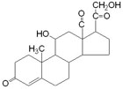
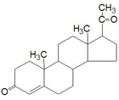
Steroid Hormones
 | Progesterone: responsible for changes associated with the menstrual cycle and with differentiation factor for mammary glands
 | Aldosterone: raises blood pressure and fluid volume, increases Na⁺ uptake
 | Testosterone: male sex hormone synthesized in the testes, responsible for secondary male sex characteristics
 | Estradiol: an estrogen, principal female sex hormone, produced in the ovary, responsible for secondary female sex characteristics
 | Cortisol: involved in stress adaptation, elevates blood pressure and Na⁺ uptake, numerous effects on the immune system

Slide 35
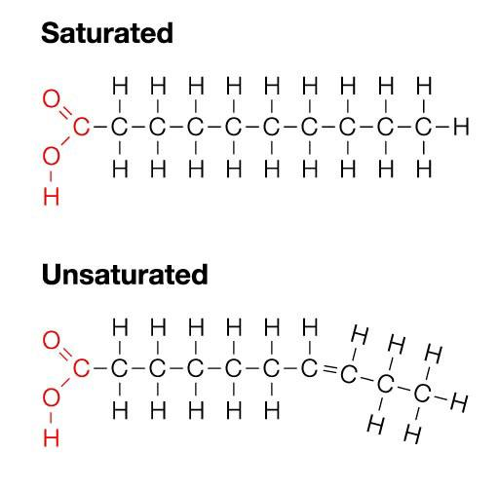
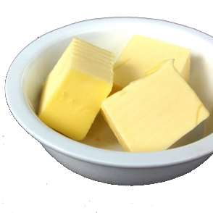
Saturated fats:
Saturated fatty acid
Their fatty acids
have no double bonds between carbon atoms(have maximum number of hydrogen atoms)
Straight structure
Unhealthy fats usually from animal sources
Solid at room temperature(20°C)

Slide 36
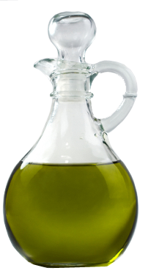
Unsaturated fats
Unsaturated fatty acid
Their Fatty acids have:
Have some carbon atoms that are double bonded(not fully hydrogenated)
Kinked in shape
Healthy
From plant sources
  Liquid at room temperature (20°C)

Slide 37
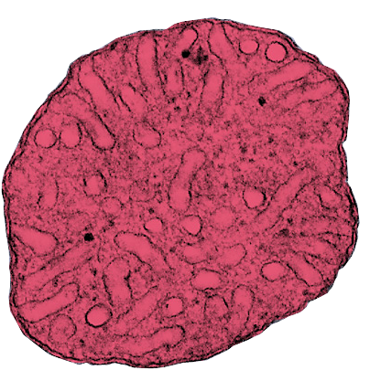
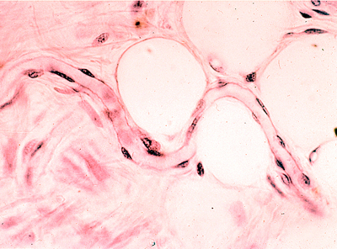
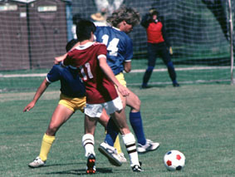
Purpose; Biological Role
Used to store energy (approx 36 kj/gram)
Fat cell
Mitochondrion
(false color TEM)
Lipids are often stored in special adipose tissue, within large fat cells
Lipids are concentrated sources of energy and can be broken down (through fatty acid oxidation in the mitochondria) to provide fuel for aerobic respiration

Slide 38
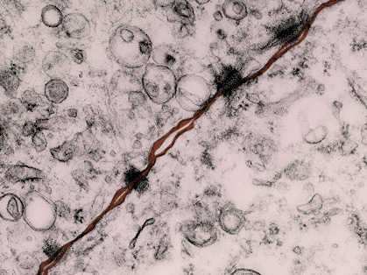
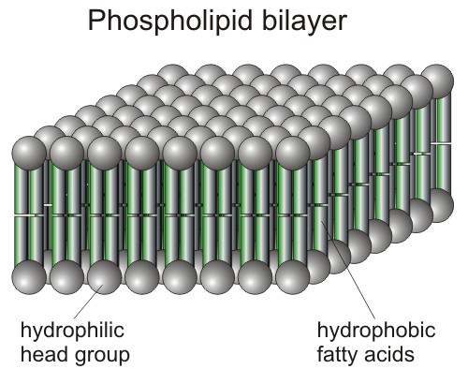
Purpose; Biological Role
An important structural component of membranes
Phospholipids are the primary structural component of all cellular membranes, such as the plasma membrane (false color TEM above).
Notes:
Phospholipid image: http://www.bing.com/images/search?q=phospholid&view=detail&id=92828062C58B38B527D77D5923E8181B46DB7A9B&first=0&FORM=IDFRIR

Slide 39
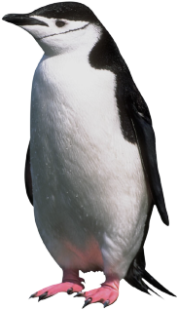
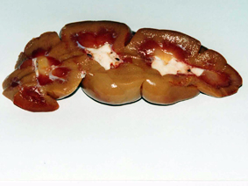
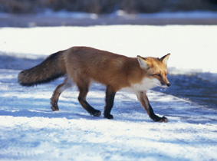
Purpose; Biological Role
acts as a shock absorber
and good insulator
The white fat tissue (arrows) is visible in this ox kidney
Fat absorbs shocks. Organs that are prone to bumps and shocks (e.g. kidneys) are cushioned with a relatively thick layer of fat.
Stored lipids provide insulation in extreme environments. Increased body fat levels in winter reduce heat losses to the environment.

Slide 40
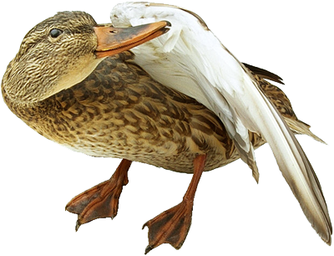

Purpose; Biological Role
Water proofing of some
surfaces
Transmission of
chemical messages
via hormones
Waxes and oils, when secreted on to surfaces provide waterproofing in plants and animals.

Slide 41
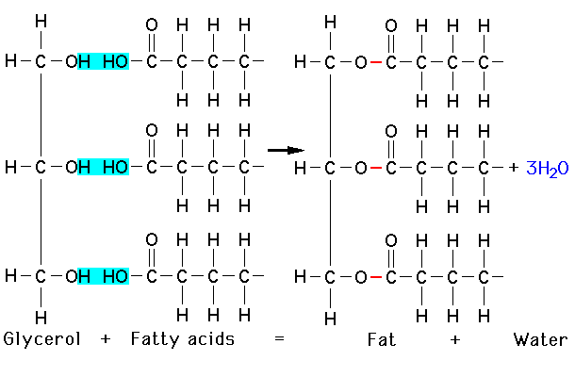
Forming a triglyceride
NOT a Polymer
Notes:
Image:http://images.google.com/imgres?imgurl=http://www.agen.ufl.edu/~chyn/age2062/lect/lect_02/of2_6.gif&imgrefurl=http://www.agen.ufl.edu/~chyn/age2062/lect/lect_02/lect_02.htm&h=490&w=738&sz=10&tbnid=BolDwkhEmk2UQM:&tbnh=92&tbnw=139&hl=en&start=5&prev=/images%3Fq%3Dmonosaccharides%26svnum%3D10%26hl%3Den%26lr%3D

Slide 42
Nucleic Acids
Comprising elements: C, H , O, P, N
Deoxyribonucleic Acid (DNA)
  Encodes information used to assemble proteins.
Ribonucleic Acid (RNA)
  Reads DNA-encoded information to direct protein synthesis.

Slide 43
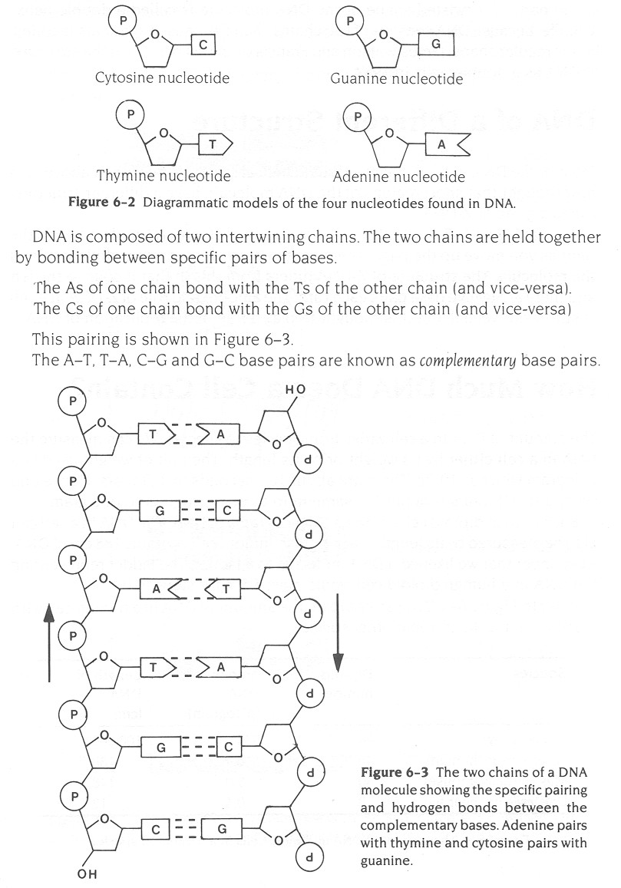
DNA nucleotides

Slide 44
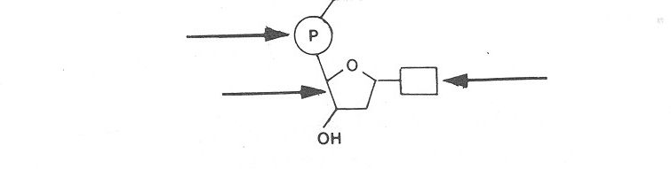
Nucleotide structure
5’
Phosphate group
Nitrogen base
(A,G,C,T)
Deoxyribose
(sugar)
3’

Slide 46
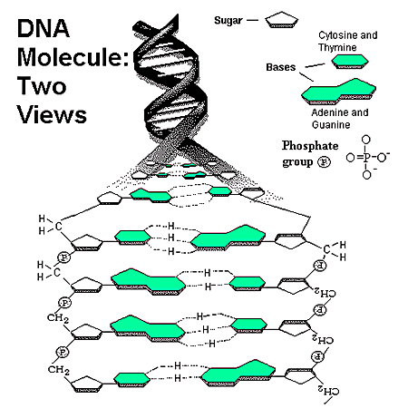
pyrimidines
purines

Slide 47
