Slide 1
DNA copying
S-phase
Copying = Replication = Synthesis = Duplication
Each cell undergoing division must copy its entire DNA, so each daughter cell gets a complete copy.
Diploid cell needs 2 copies of each chromo
Rate of synthesis
  Bacteria = 1000 bases per second
  Mammals = 100 bases per second
Problem:
  Bacteria genome is 4 x 10⁶. Takes 20 minutes to copy.
  Human is 3.2 x 10⁹. Would take 10,000 times longer.

Slide 2
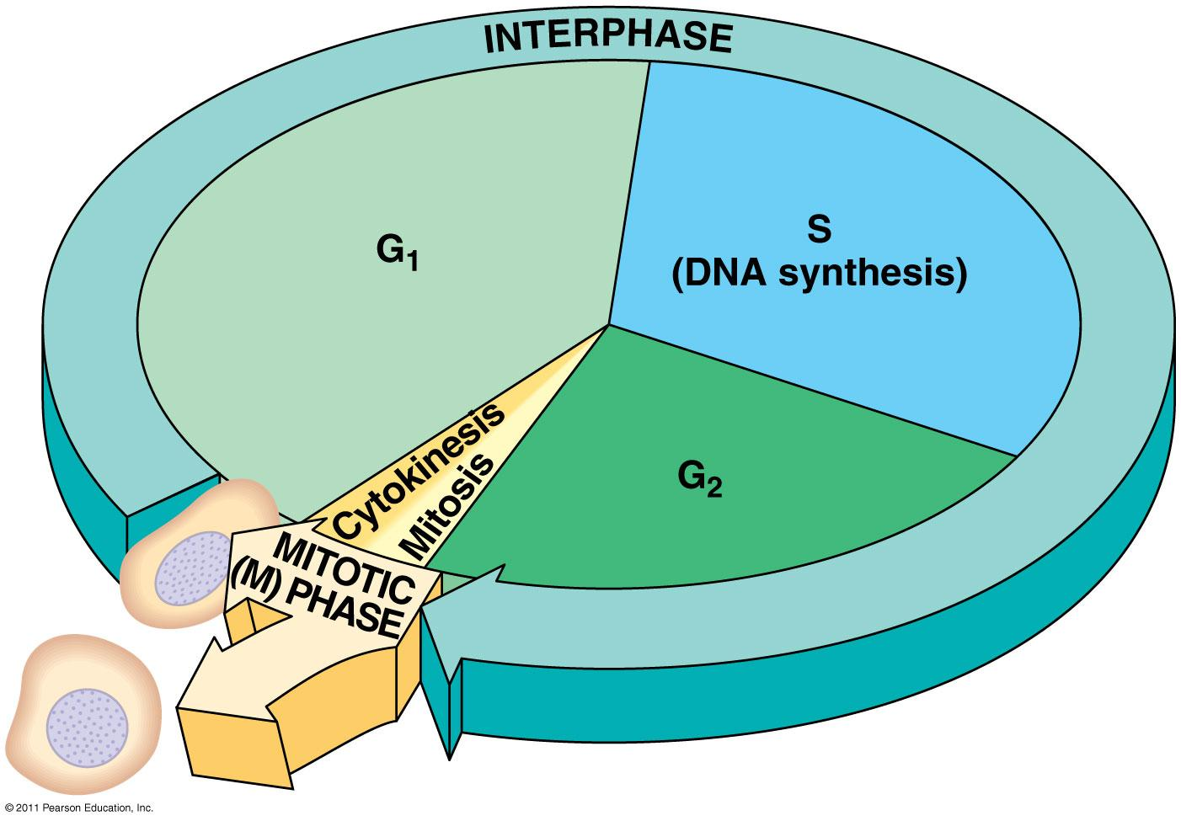
The cell cycle consists of
  Interphase – normal cell activity
  The mitotic phase – cell division

Slide 3
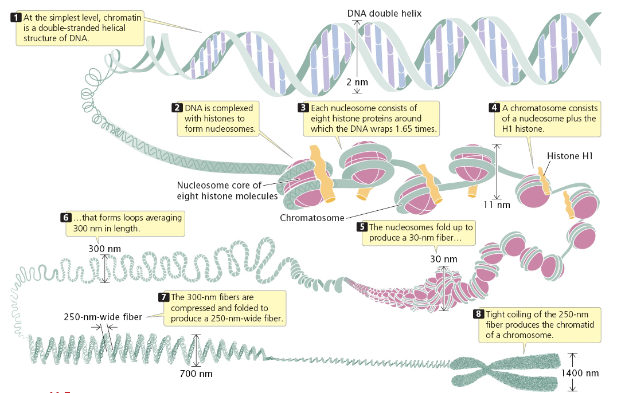
DNA Packaging

Slide 4
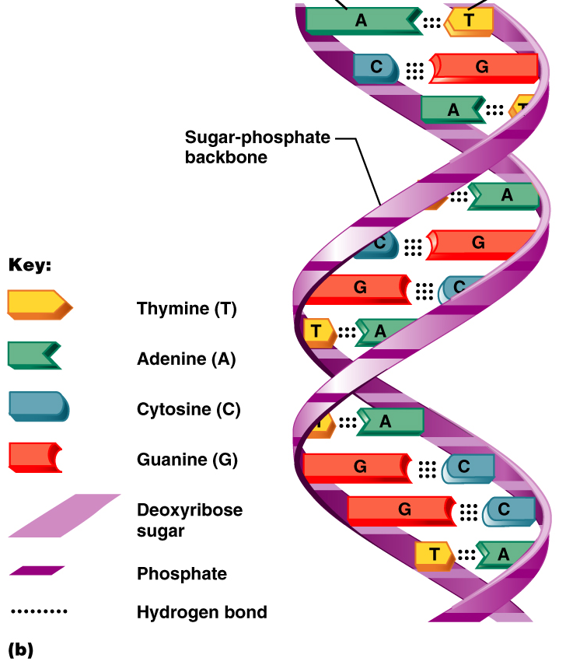
Structure of
DNA

Slide 5
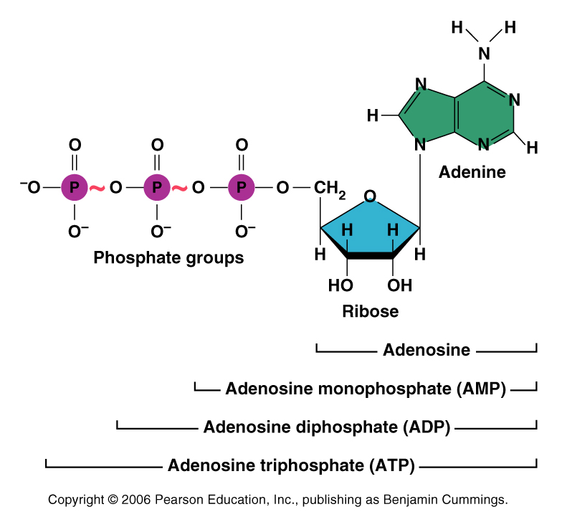
A nucleotide: ATP
Energy storage for cells
Many enzymes use ATP
Provides a way to run reactions that are otherwise endergonic (require energy)

Slide 6
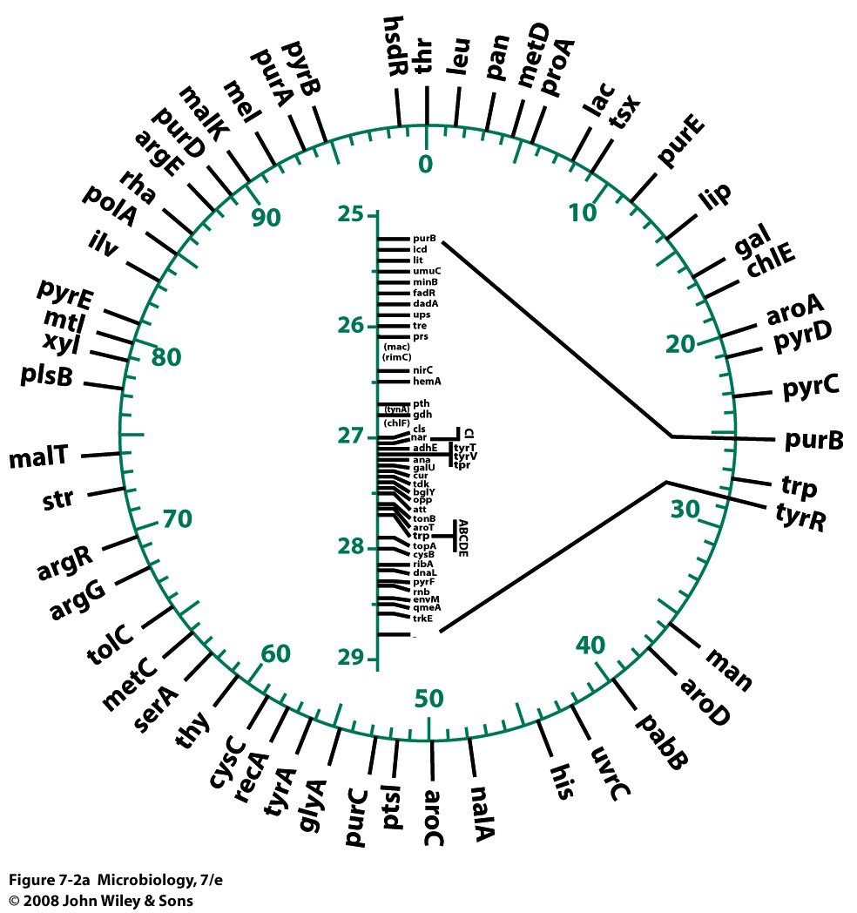
Chromosomes
Chromosomes
  Strands of DNA that contain all of the genes an organism needs to survive and reproduce
Genes
  Segments of DNA that specify how to build a protein
    genes may specify more than one protein in eukaryotes
  Chromosome maps are used to show the locus (location) of genes on a chromosome
The E. Coli genome includes approximately 4,000 genes

Slide 7
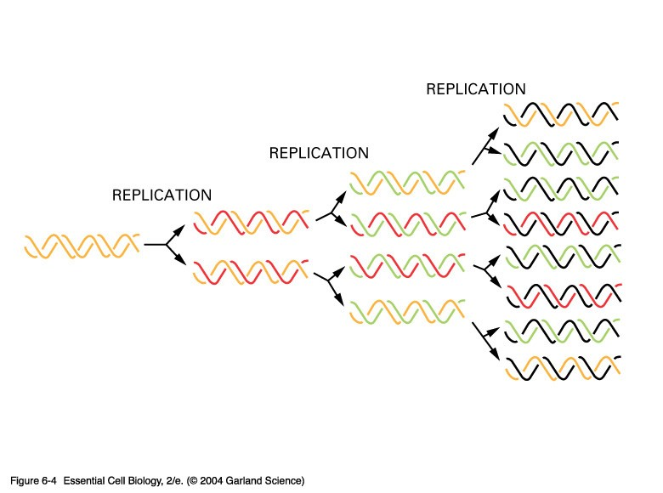
06_04_replic.rounds.jpg

Slide 8
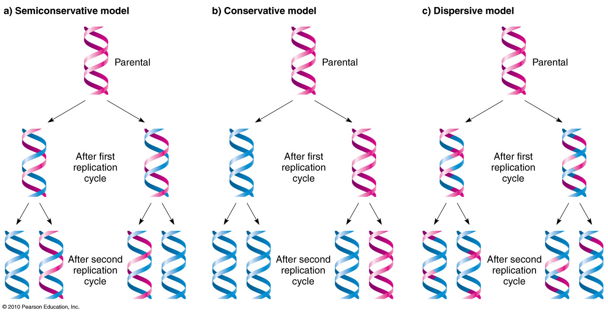

Slide 9
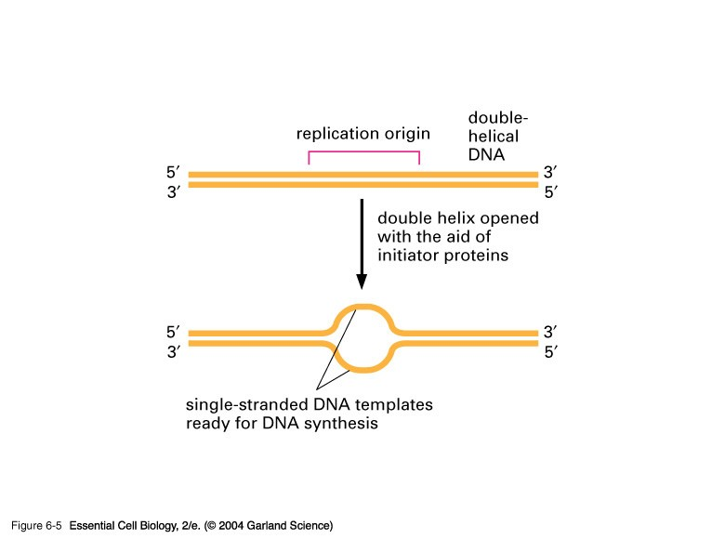
06_05_replic.origin.jpg

Slide 10
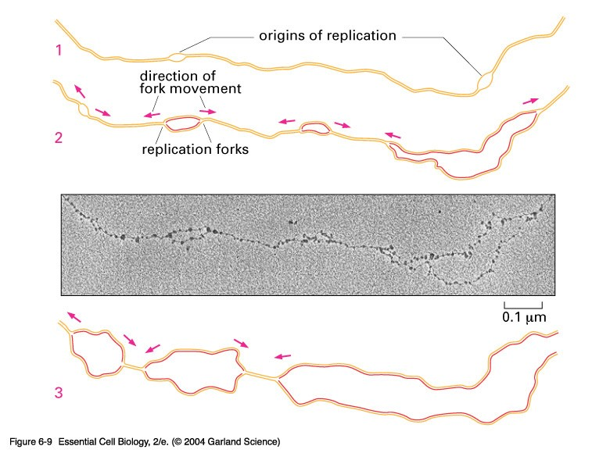
06_09_Replic.forks.jpg

Slide 11
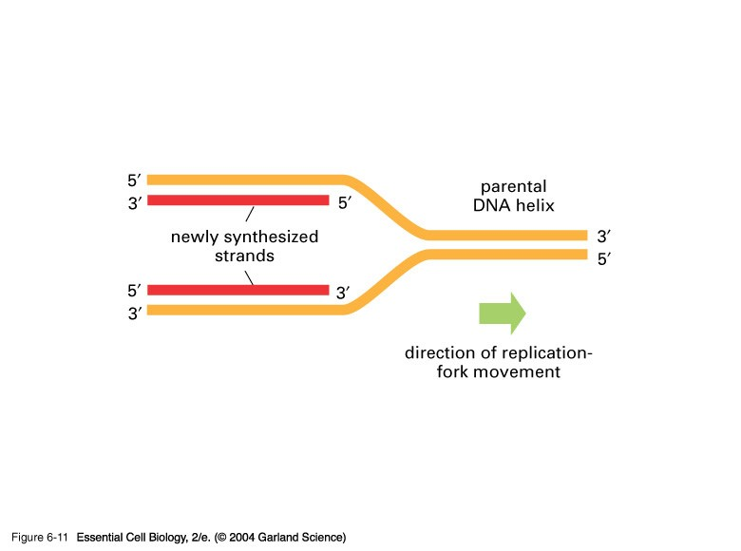
06_11_oppositepolarity.jpg

Slide 12
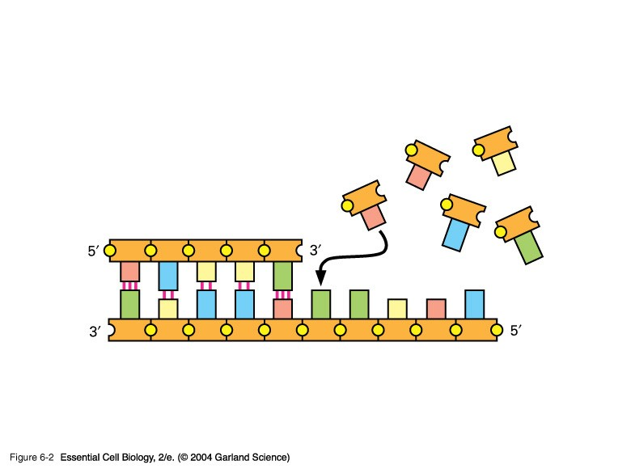
Schematic 1

Slide 13
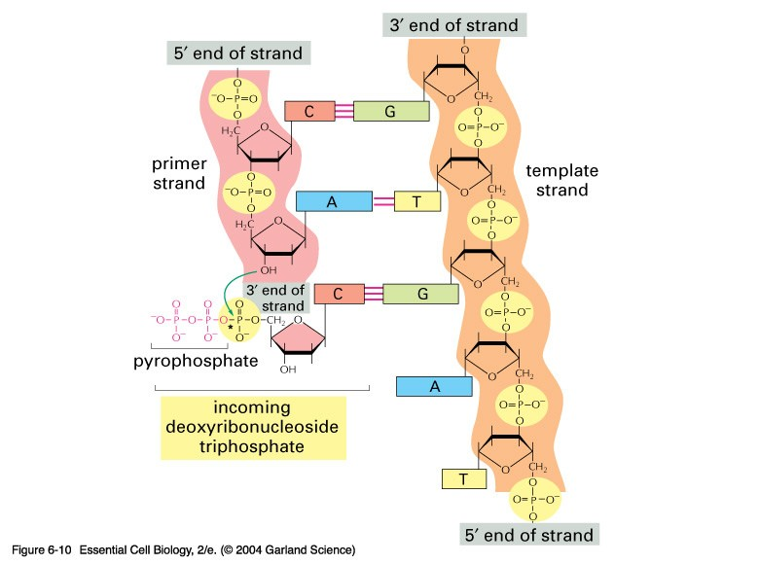
Schematic 3

Slide 14
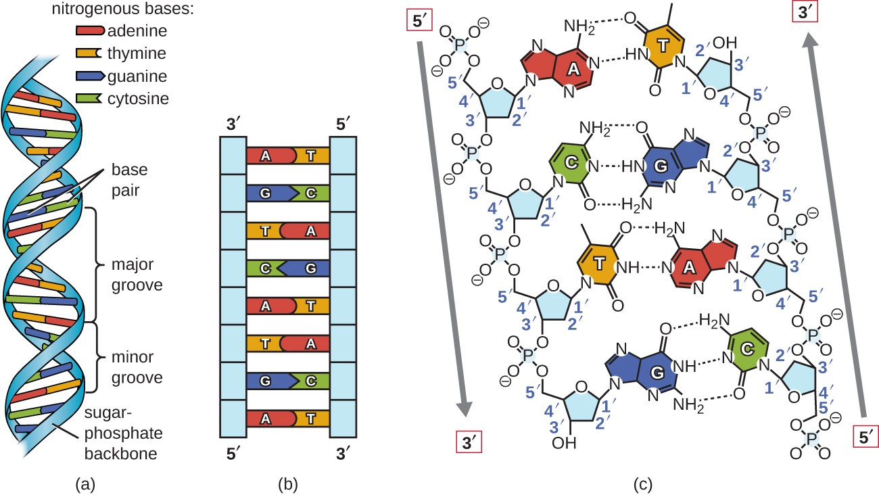

Slide 15
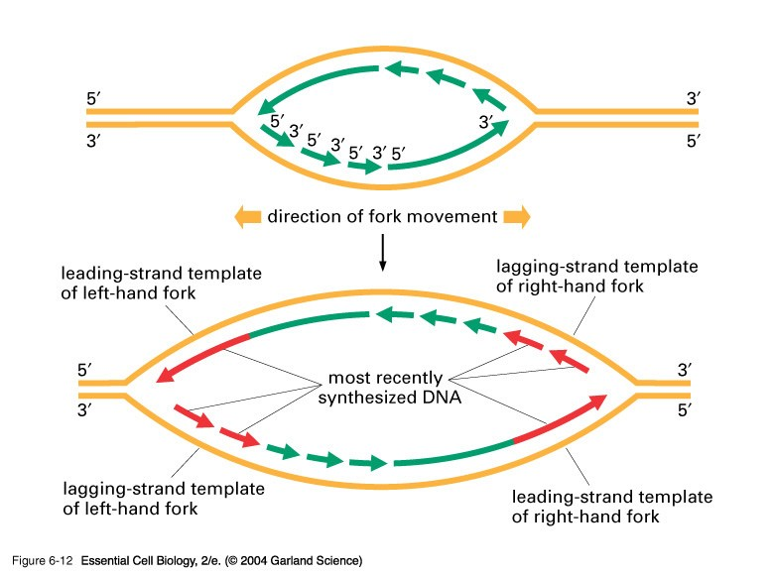
06_12_asymmetrical.jpg

Slide 16
What happens at the other strand?
3’ to 5’ strand replication
Solved by Reiji Okazaki
He saw - one strand made in a continuous manner (leading strand) and the other from short discontinuous pieces (lagging strand)
The discontinuous pieces are known as Okazaki fragments

Slide 17
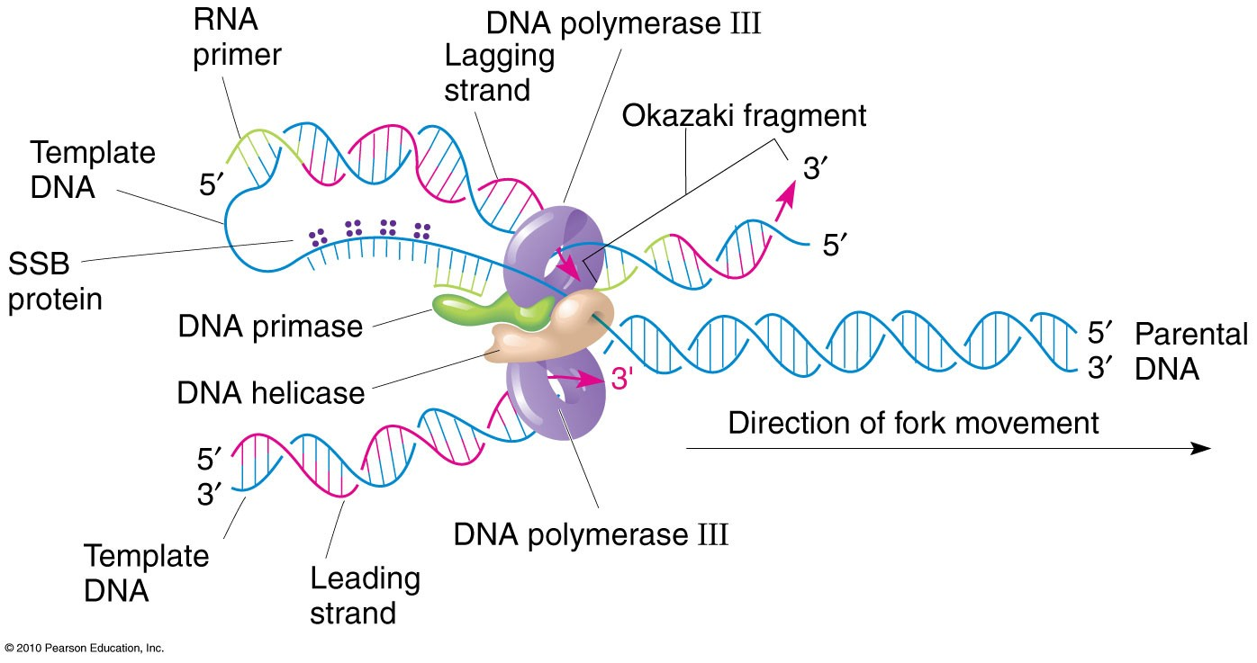
Trombone model

Slide 18
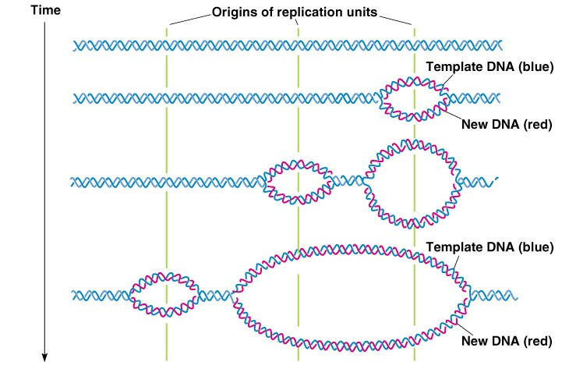
Each eukaryotic chromosome is one linear DNA double helix
Average ~10⁸ base pairs long
With a replication rate of 2 kb/minute, replicating one human chromosome would require ~35 days.
Solution ---> DNA replication initiates at many different sites simultaneously.
Rates are cell specific!
Fig. 3.14

Slide 19
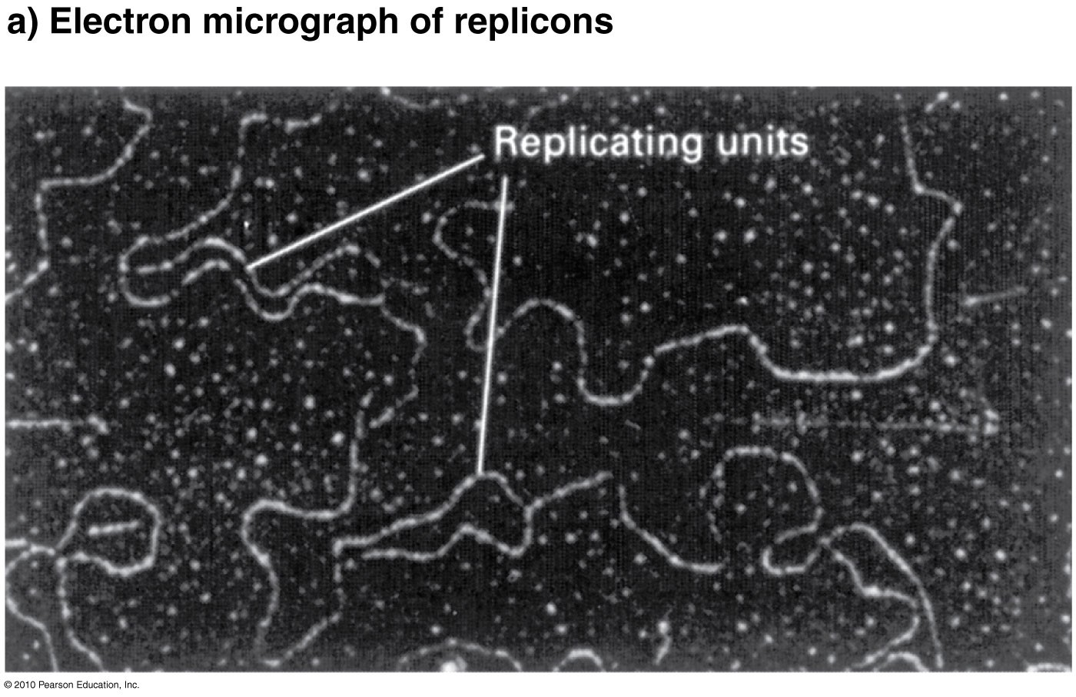
Fig. 3.13 - Replication forks visible in Drosophila

Slide 20
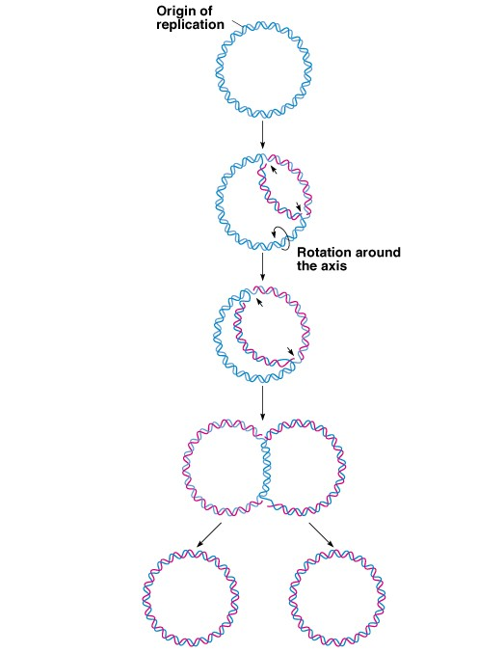
Replication of circular DNA in
E. coli (3.10):
Two replication forks result in a theta-like (θ) structure.
As strands separate, positive supercoils form elsewhere in the molecule.
Topoisomerases relieve tensions in the supercoils, allowing the DNA to continue to separate.

